Slide 1
1.虚拟地址和物理地址的转换
知道VA所对应PA有什么好处呢
-在没有代码的情况下可通过MS TV TOOL dump出内存的资料

Slide 2
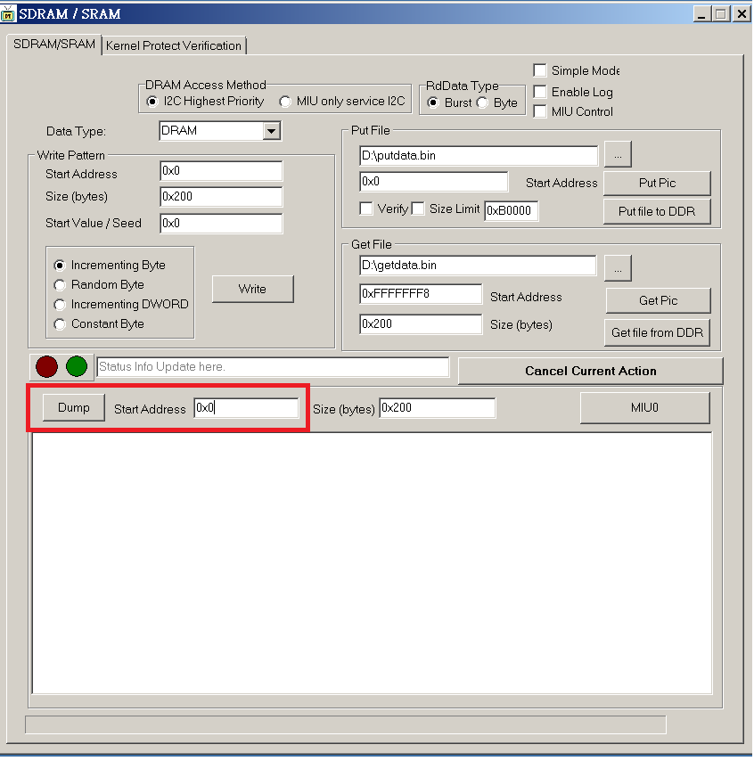

Slide 3
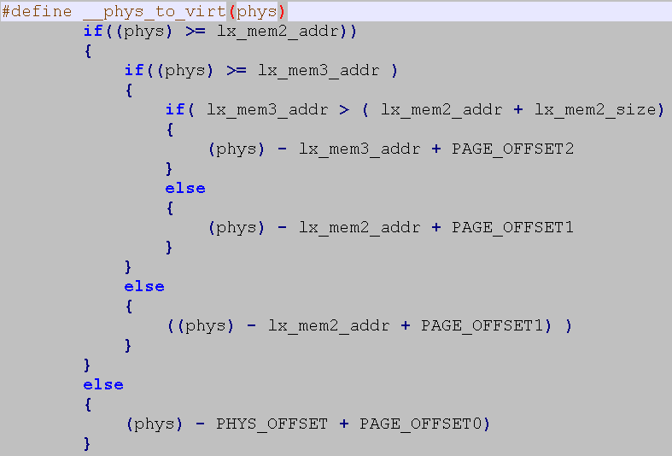
BA→VA 转换函数定义: \kernel\mstar2\hal\k6lite\cpu\include\mach\memory.h
#define _phys_to_virt(phys)
#define _virt_to_phys(virt) 转换伪代码如下：
PHYS_OFFSET
--The physical address of the start of the memory
0X20200000
PAGE_OFFSE
--The virtual address of the start of the kernel image
0XC0000000
0X2020000
0XC000000

Slide 4
LX1 和LX2地址映射
CPU
LX2
0xFFFFFFF
Kernel space
LX2
1G
LX1
0xA0000000
0xC080000
LX1
0xC000000
User space
0x20280000
3G
0x20200000
0x0000000
0x20000000
Security Level: Confidential A

Slide 5
虚拟地址、物理地址、实际内存的对应关系
VA
BA
PA (51)
CPU
MIU1
DRAM
0xFFFFFFF
Kernel space
1G
0xA0000000
0xC080000
MIU0
0xC000000
User space
0x00280000
0x20280000
3G
0x20200000
0x00200000
0x0000000
0x20000000
0x00000000
Security Level: Confidential A
Notes:
总线地址：是从外设看到的地址，如power pc、x86等，访问外设io有专门的指令
但是arm对外设和ram统一编址，所以总线地址等于物理地址，但是linux中为了兼容保留了这个概念
总线地址举例：比如有些DMA访问外设，cpu看到DMA的地址是虚拟地址，但是DMA看外设的地址就是总线地址
注意：内核起来后，只要mmu初始化成功，cpu看到的地址都是虚拟地址

Slide 6
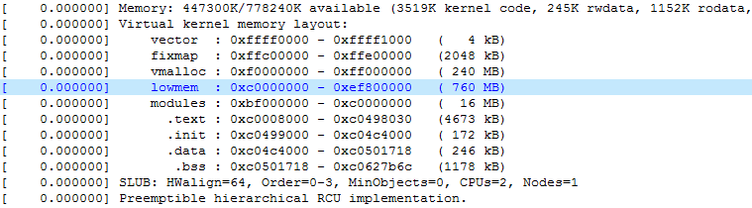
内核虚拟地址layout
Notes:
1. vector: 重定向向量表，如中断向量表
2. fixmap： 固定映射区，一般用来分配大页内存
3. vmalloc: 虚拟内存申请的内存，前三个一般指高端内存
4. lowmen： 直接物理内存映射区，与RAM 1：1映射，就是我们的LX
5. modules: 内核模块空间，内核模块通过insmod命令加载，会动态的映射到这里
6. .text: 内核代码加载的地方
7. .init: 内核中的init段，就是定义时前面加init的代码段
8. .data: 数据区，一般存放已初始化全局变量和一些静态变量
9. .bss: 一般存放已初始化全局变量

Slide 7
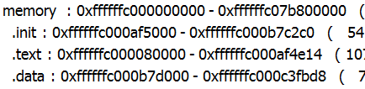
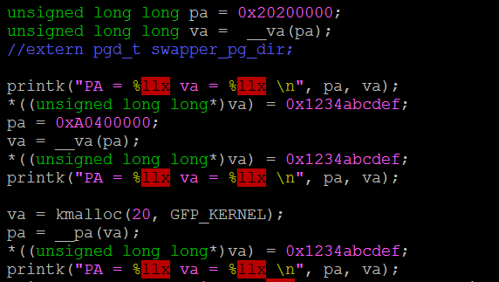
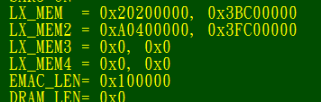

2. 一些内存api介绍
__pa(vAddr)
Make sure vAddr locates at lowmem:
__va(pAddr)
Runtime representation
LX2
LX_MEM2’s PA head
LX2
LX1
LX1
The same
Security Level: Confidential A

Slide 8
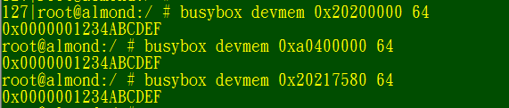
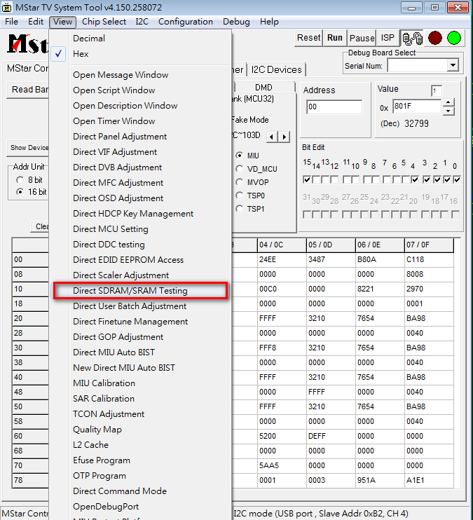
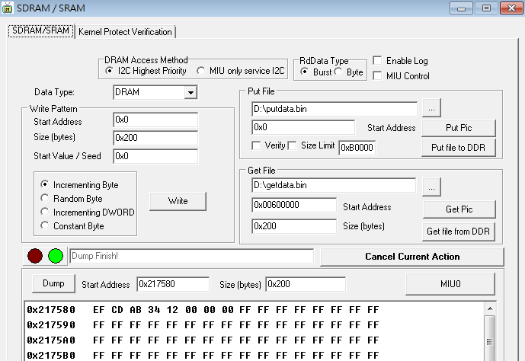
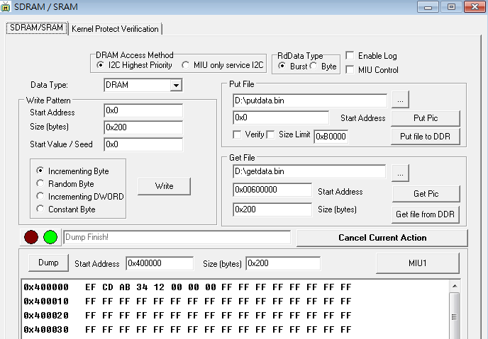
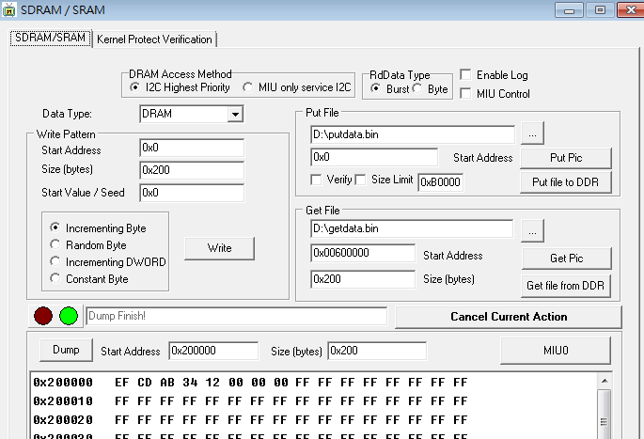
Use devmem to verify (devmem use bus address, remember!!)
Use 51 to verify
Security Level: Confidential A

Slide 9
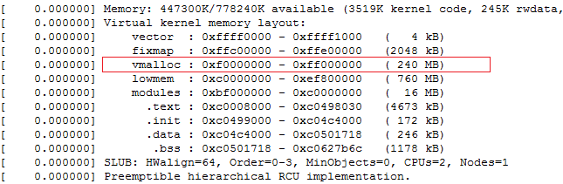
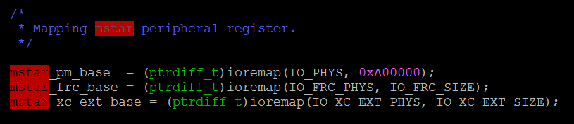
Ioremap/iounmap
将物理地址/RIU地址映射到虚拟地址
在系统中是不能直接访问RIU的，必须要进行映射才能访问
Security Level: Confidential A
Notes:
Mstar的RIU地址一般是0x1F000000,这地址一般芯片设置好就固定了
映射地址一般是0xFD000000

Slide 10
RIU地址和虚拟地址的转换
If offset is 8 bit
(Bank補兩個0)*2 + offset * 2
If offset is 16 bit
(Bank補兩個0)*2 + offset * 4
Example
Given 1CD71C
Bank = 1CD7
Offset = 0x1C
8bit
1CD700 * 2 + 1C *2 = 0x1f39AE38-----------------------------for Devmem
1CD700 * 2 + 1C *2 = 0x(mstar_pm_base) + 39AE38-------for code
16bit
1CD700 * 2 + 0E *4 = 0x1f39AE38-----------------------------for Devmem
1CD700 * 2 + 1C *2 = 0x(mstar_pm_base) + 39AE70-------for code
Security Level: Confidential A
Notes:
此处需要注意访问8位寄存器地址的情况

Slide 11
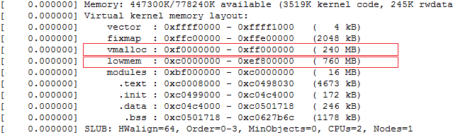
Kmalloc v.s vmalloc
Most important thing is:
Don’t forget to kfree/vfree memory after use.
Security Level: Confidential A

Slide 12
2. Devmem/tv tool的使用方法
Devmep主要是提供给driver开发人员，在应用层侦测内存地址中的数据变化，比如在debug console动态的检测内存中数据的正确性

Slide 13
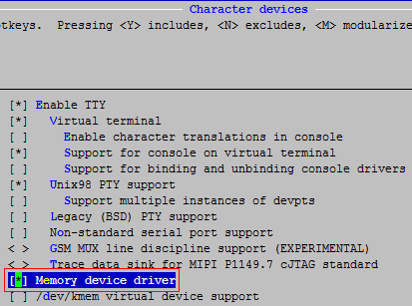
如何打开devmem的功能
Security Level: Confidential A

Slide 14
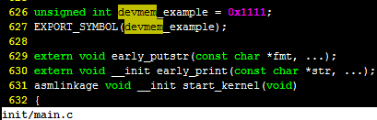
可以先在kernel中定义个变量来测试
Security Level: Confidential A

Slide 15
build完kernel后用命令从vmlinux里面查出定义的变量的虚拟地址
$ arm32-linux-gnu-nm vmlinux | grep"devmem"
c0c796a0 D devmem_example
进行地址转换VA->PA
phy addr = VA – 0xc0000000 + 0x20200000
= c0c796a0 – 0xc0000000 + 0x20200000
= 0x20E796A0
Security Level: Confidential A

Slide 16
得到物理地址后就可以在控制台通过devmep dump读出数据了
读值方法 busybox devmem [ADDRESS] [LEN(bit)]
# busybox devmem 0x20E796A0
0x00001111
写值方法 busybox devmem LEN(bit) [ADDRESS] [VALUE]
# busybox devmem 0x20E796A0 16 0xabcd
# busybox devmem 0x20E796A0
0x0000ABCD
Security Level: Confidential A

Slide 17
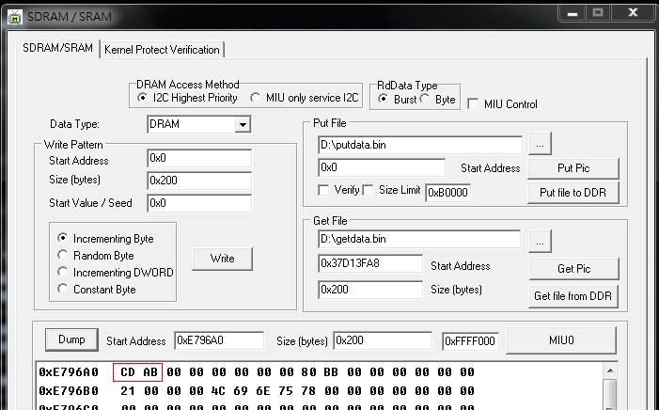
TV_Tool去dump DRAM数据
地址： 0x20E796A0 -0x20000000 = E796A0
Security Level: Confidential A
Notes:
前面讲过物理地址是从0x20000000开始的，对应dram 0x000000000的位置

Slide 18
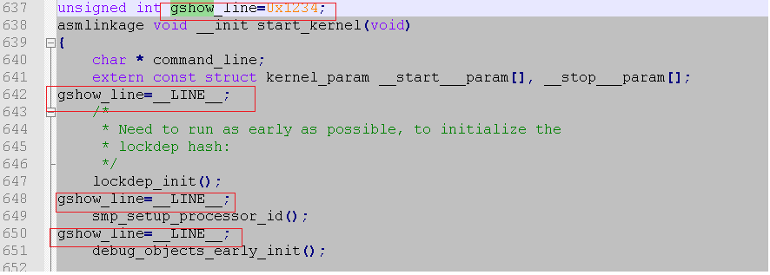
一些有用的调试小技巧 在移植kernel的时候，一开始没有log打印 可以通过下面的方法来查看程序跑到哪里了
Security Level: Confidential A

Slide 19
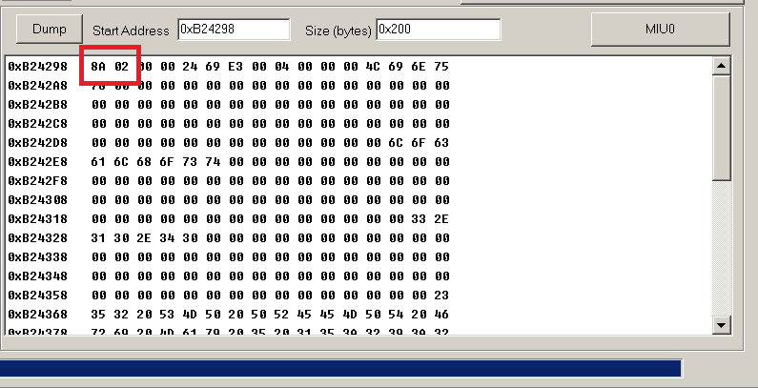
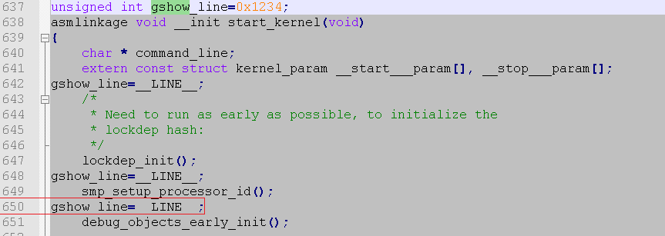
arm-none-linux-gnueabi-nm vmlinux | grep gshow_line
c0924298 D gshow_line
TV_Tool去dump DRAM 使用 0x20 0000+ 924298
Security Level: Confidential A

Slide 20
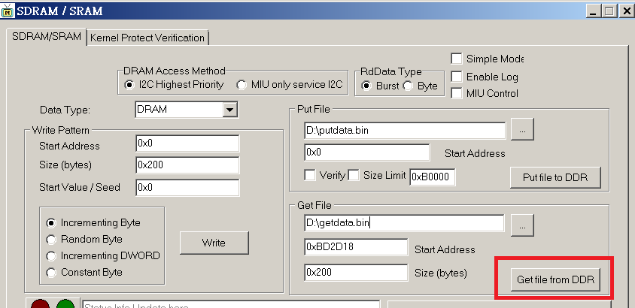
Dump __log_buf的数据
arm-none-linux-gnueabi-nm vmlinux | grep __log_buf
c09d2d18 b __log_buf
TV_Tool去dump DRAM 使用 0x20 0000+ 9d2d18
Security Level: Confidential A

Slide 21
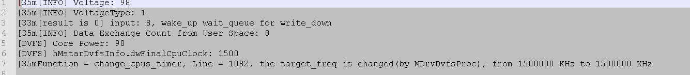
将存下來的bin file 放到server並执行
strings [Bin file] >test.log
例如 #strings getdata.bin >test.log
執行結果
Security Level: Confidential A

Slide 22
3.在kernel中增加调试节点
一般在proc中增加一个调试node，然后通过echo输入不同的值，做对应的流程控制
输入不同值，控制程序执行不同的代码段
输入不同值，对打印的log进行控制

Slide 24
4.内存泄漏检测Kmemleak
这是kernel中原有的功能
这个功能主要用来检测内存泄漏
这个功能可以检测哪些内存泄漏
kmalloc/kzalloc, vmalloc, kmem_cache_alloc

Slide 25
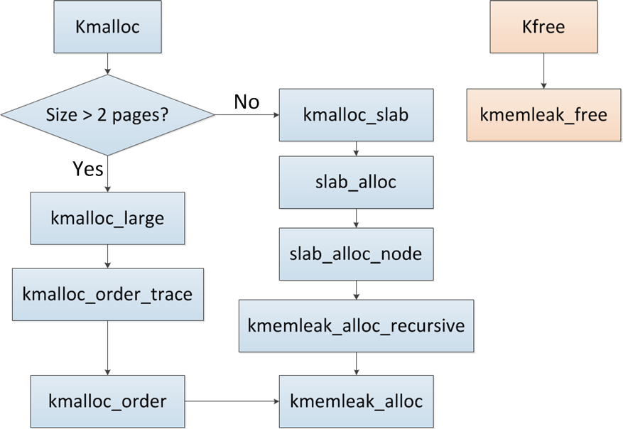
KmemLeak work flow

Slide 26
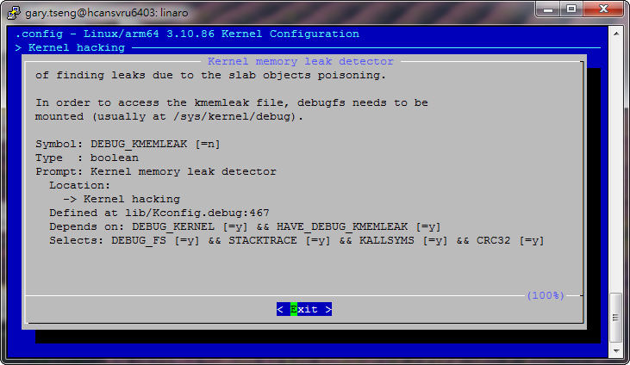
如何打开kmemleak的功能CONFIG_DEBUG_KMEMLEAK in “Kernel hacking” has to be enabled

Slide 27
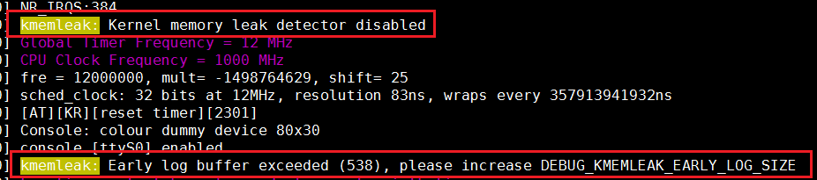
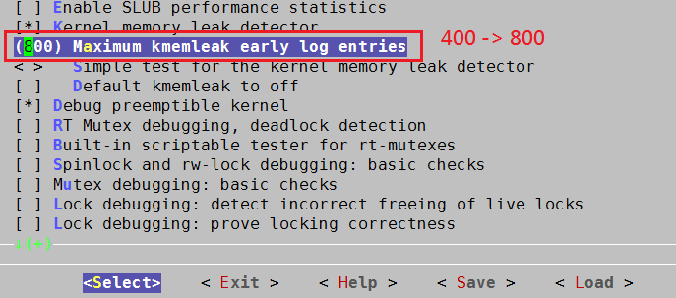
如果有打印log buffer超出则自己调整一下

Slide 28
Kmemleak的一些命令
立即触发一次内存扫描:
# echo scan > /sys/kernel/debug/kmemleak
获取内存泄漏信息:
# cat /sys/kernel/debug/kmemleak
清空当前的内存泄漏信息:
# echo clear > /sys/kernel/debug/kmemleak
如果“/sys/kernel/debug/kmemleak” 不存在, 尝试mount debugfs
# mount -t debugfs nodev /sys/kernel/debug/

Slide 29
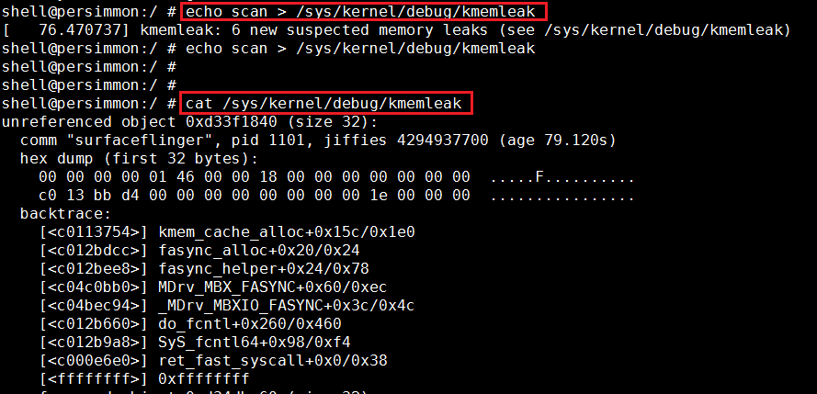
内存泄漏信息
You will see the kmemleak report format
Size = memory allocate size
Age = how long this memory exist in system

Slide 30
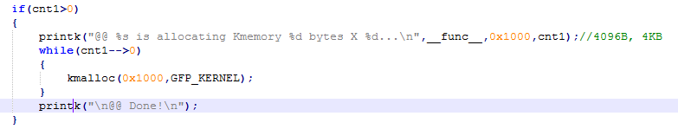
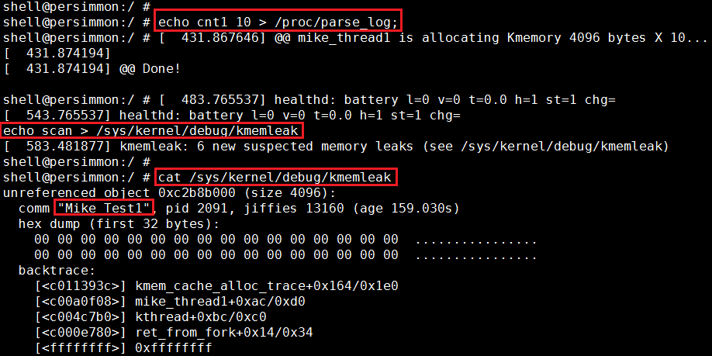
Example

Slide 31
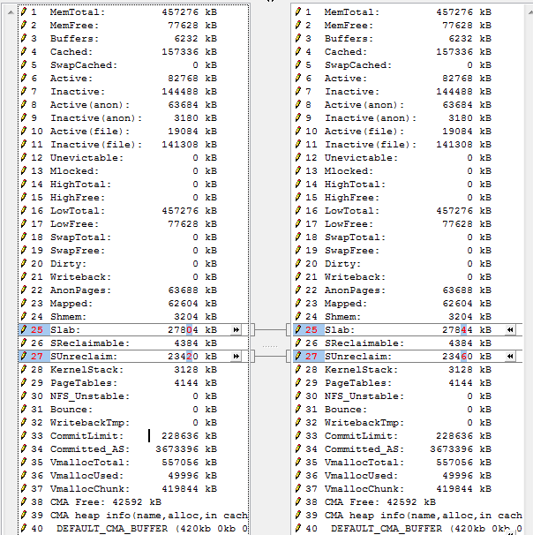
Meminfo显示的内存信息Kmemory 4096 bytes X 10...

Slide 32
5.MIU and MIU protect
Miu：内存接口单元，我们对dram的访问都通过miu来进行

Slide 33
MIU architecture
IP
G0
Path
Select
DRAM
Mask
Address Bus
MIU 0
G0
IP
G1
G1
G2
G3
Data Bus
IP
G2
DRAM
MIU 1
Address Bus
G0
G1
IP
G3
G2
G3
Data Bus
reg_miu_sel
Notes:
每个miu可以对4块内存区域进行保护

Slide 34
MIU Protection Architecture
Client ID
MIU
0x0000000
ID=0
Mheg5-Aeon
ID0
ID1
0x1700000
U32Start
1st
Block 0
0x1702000
U32End
ID=1
ADP-Aeon
ID2
ID3
0x2100000
2nd
Block 1
0x2102000
ID=2
HK51
ID4
ID5
0x3100000
3rd
Block 2
0x3102000
ID=3
MAD
MVD
…
…
0x3200000
ID6
ID7
4th
Block 3
0x3202000
Notes:
被保护的区域，只有加到白名单中的client才允许访问，每块区域最多可以添加15个白名单

Slide 35
MIU protect
MIU Protect
Protect an area of ram to prevent all MIU clients but some specific clients to write it.
Architecture Introduce
Hardware provide 4 blocks for MIU protection.
Each protected ID correspond MIU client ID
API:
MDrv_MIU_Protect (U8 Blockx, U8 *ProtectId, U32 u32Start, U32 u32End, BOOLEAN bEnable)
Blockx is regarded as block ID (0~3), protectId is regarded as protected client ID, U32Start & U32End are regarded as the start address and end address of protection region, bEnable is regarded as turning on/off MIU protect
Protect start/end address unit is 8KB
Associated code is referenced to drvMIU.c/.h
Bus addr

Slide 36
用tv tool对miu做protect

Slide 37
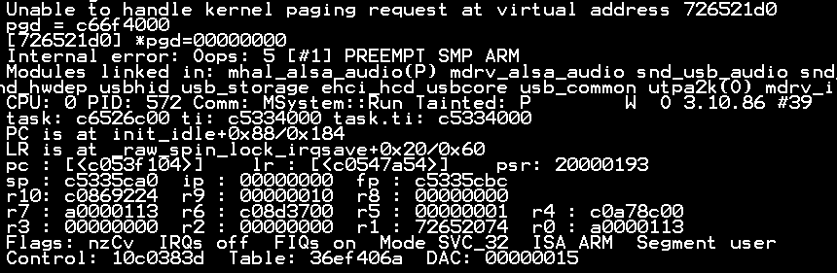
6.Kernel panic 跟踪
什么是kernel panic
就是操作系统检测到一个它无法处理的内部错误，然后打印出相应的log
Kernel panic description
Death location
Register Info
Notes:
Kernel panic：发生在kernel空间的错误
Coredump：发生在用户空间的错误

Slide 38
PC (program counter) kernel死的地方
LR (Link register) 返回地址
SP (stack pointer) 堆栈指针
R0~R10: 一般寄存器
Kernel panic description
Death location
Register Info

Slide 39
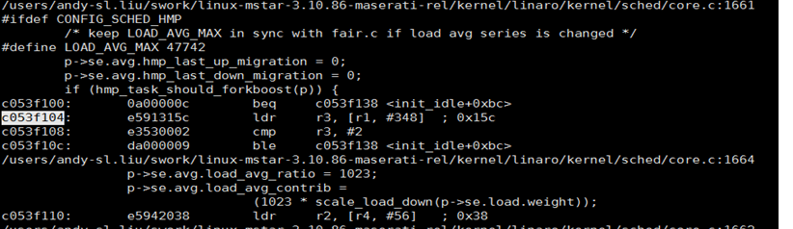
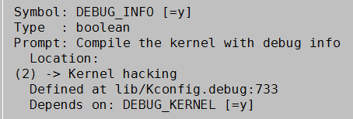
首先我们得从vmlinux中找到pc的地址
PC: 0xc053f104
arm-none-linux-gnueabi-objdump -S vmlinux
Address
Instruction code
Assambly code
Notes:
Display information from object <file(s)>.
-S, --source Intermix source code with disassembly
-l, --line-numbers Include line numbers and filenames in output

Slide 40
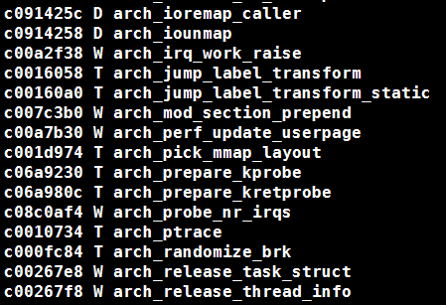
Or you can view symbol and its VA mapping by
arm-none-linux-gnueabi-nm -S vmlinux
arm-none-linux-gnueabi-objdump -S vmlinux

Slide 41
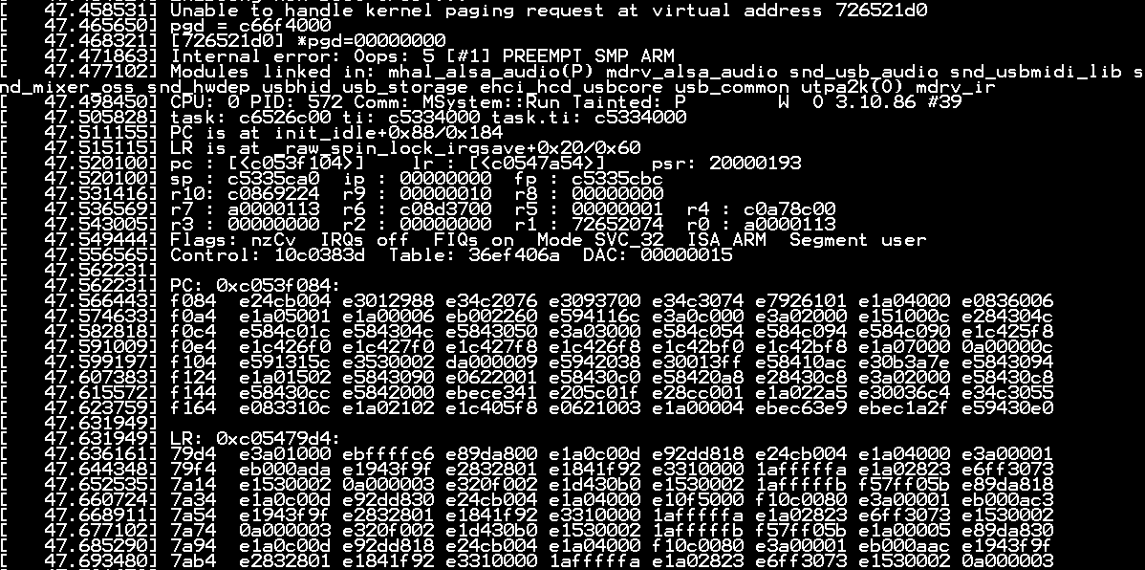
Kernel Panic status in Console
PC = Init_idle+0x88 = 0xc053f104
Memory violation
PC is here
PC’s instruction code is here
Address
Instruction code

Slide 42

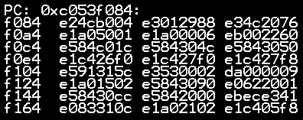
检查vmlinux和Kernel panic log是否匹配
vmlinux
Kernel panic log

Slide 43
r3 = r1+0x15c (r3 comes from r1, so go check r1)
r1 = r4+0x16c (r1 comes from r4, so go check r4)
We observe that r4 hasn’t been modified for a long time.
r4 is a suspect, so go check r4’s address
Notes:
R1+#348得出的值並非在 LX裡面，照理來說kernel只會在LX裡面去讀資料 (ldr r3, [r1, #348])?
所以是mboot在搬移kernel資料後，又去動到LX嗎
Load LX的東西不應該有問題，所以懷疑有人去踩?

Slide 44
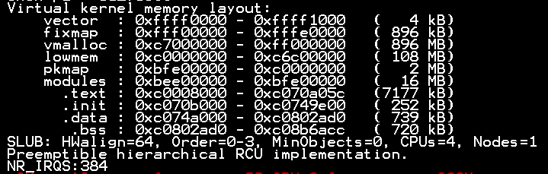

r4=c0a78c00
Seems like r4 is in the region of lowmem
We are dead at the time when mboot is finished. And swtiched hand to kernel Kernel must get the wrong address which is caused by Mboot!
Go check if mboot access kernel’s memory!

Slide 45
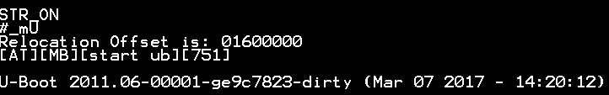


STR ON flow
Kernel MMAP
U-Boot override Kernel’s address space

Slide 46
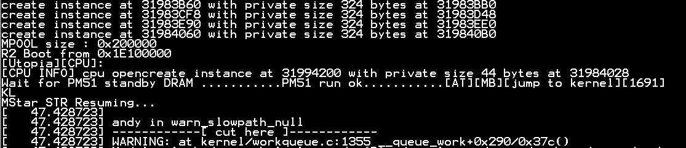
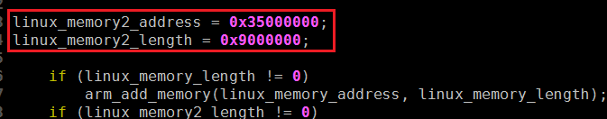
Kernel died just after Mboot finished
Solution
Mmap must prepare an buffer to Mboot!
prom_meminit( ) [mstar2/drv/cpu/arm/generic/memory.c] (hardcode)

